Slide 1
CANADIAN REAL ESTATE MARKET& ECONOMIC FACTORS
Project – Jacob Elumeze

Slide 2
Objective
Project Flow Structure
1. Connecting to APIs & Import Data
3. Review Objectives
4. Data manipulations and calculated fields
6. Create meaningful viz. & data insights
5. Building a Model & QA
2. Exploratory Analysis & Assumptions
Project centers on analyzing the Canadian Housing Market and offering insights to trends over the last four decades leveraging data on:
Real Estate Prices and
Incomes across various districts within Canada
With the insights generated, stakeholders can better understand the changes in real estate prices over the years across key cities; and also compare with changes in earnings over the years as a driver for home purchasing patterns across places of interest in Canada.

Slide 3
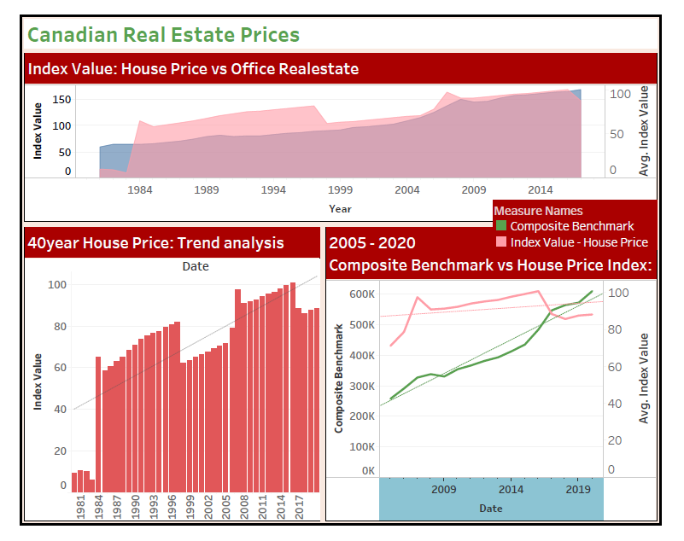
Results and findings

Slide 4
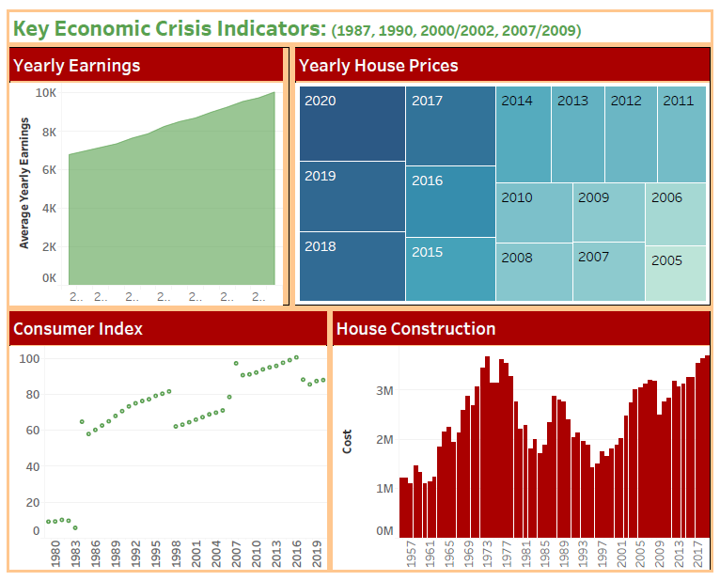
Results and findings

Slide 5
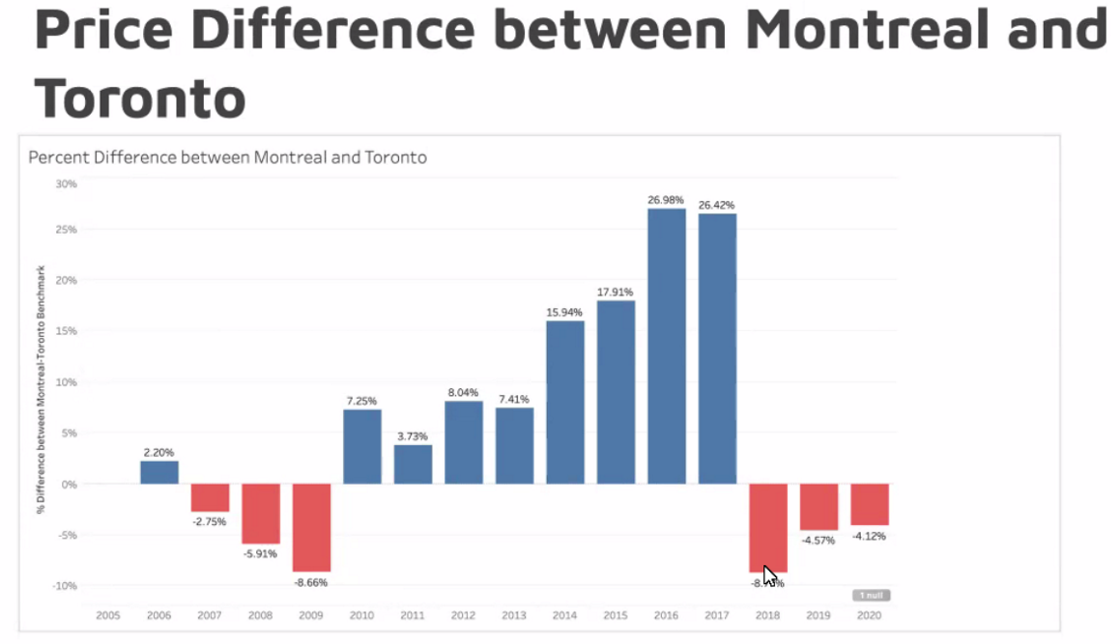
Results and findings
Comparison of house prices in Montreal against Toronto shows a faster price hike spread over the years.
However, recent trends shows the gap in house base prices closing.

Slide 6
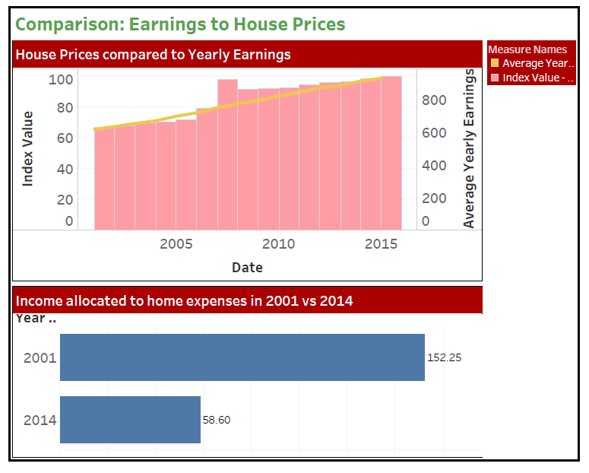
Results and findings

Slide 7
Results AND FINDINGS: INSIGHTS
The price of homes (and offices) has consistently increased in the last 40 years, with the highest jump happening between 1983 and 1984
01
01
Earnings across Canada has also grown at a consistent rate year on year.
Real Estate Price Trends
Earnings Trends
The Canadian districts with the most expensive homes are Greater Vancouver, Lower Mainland and Oakville Milton.
Across these districts, the difference in the price of homes has also stayed relatively the same.
02
02
In 2001, Canadians spent over 150% of their incomes on home expenses. But in 2014, the value dropped significantly to slightly over 50%.
Districts: Insights
Spending Insights
03
03
03
I cannot see any direct correlation between the key economic events in the past and incomes or real estate prices in Canada.
There isn't any difference between the Consumer Price Index and House Price Index over the years.
Both grew at the same rate
Contributing Factors
Business Information
There is a slight relationship with the prices of house constructions, with the cost of construction materials experiencing a dip in those key years
Key Economic Indicators
Trend Analysis on datapoints from Canadian Open Data portal

Slide 8
KEY TAKEAWAYS
Steady Increase in Home Ownership Costs
Drop in Home Prices as seen from key historical events associated with the 90’s recession and 2008 financial crisis
Average Earnings steadily increase at a slower rate in comparison to Home Price poses a challenging landscape for prospective buyers looking to get into the real estate market.
Spike in construction pricing has led to a drop in spend rate
Widening gap in regional home prices after 2014, with substantial increase which yields lucrative returns for real estate investors

Slide 9
Challenges & learning pointS
Importing the JSON file into tableau.
Understanding the dataset towards modelling relationships
Tableau tool familiarization and limitations with selecting certain visualizations.
If I had more time…
Present my results using more adequate visuals that will easily convey key insights to consumers of the report.

Slide 10
Thank You

